Slide 1
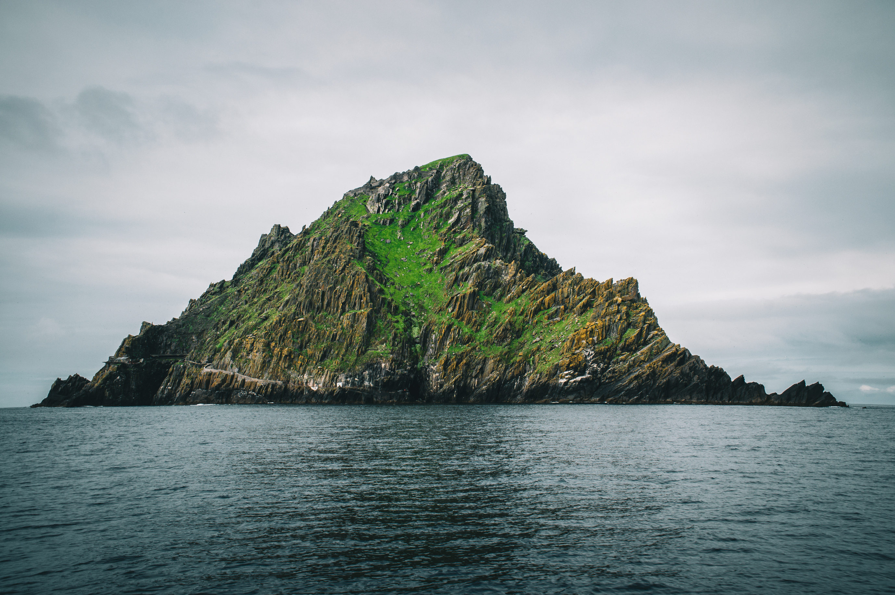



AD 400 to AD 795
Chapter 5
EARLY CHRISTIAN IRELAND
early christian ireland
Strand Two: The History of Ireland
@MsDoorley

Slide 2

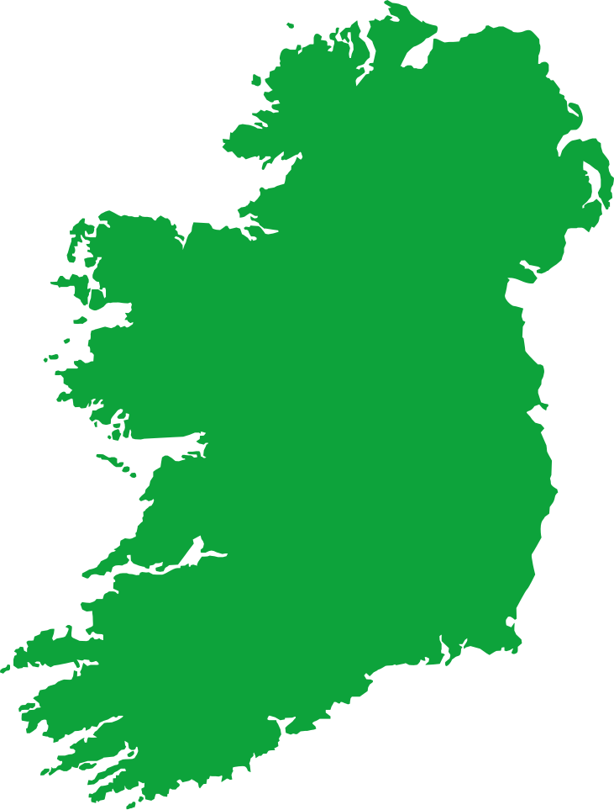
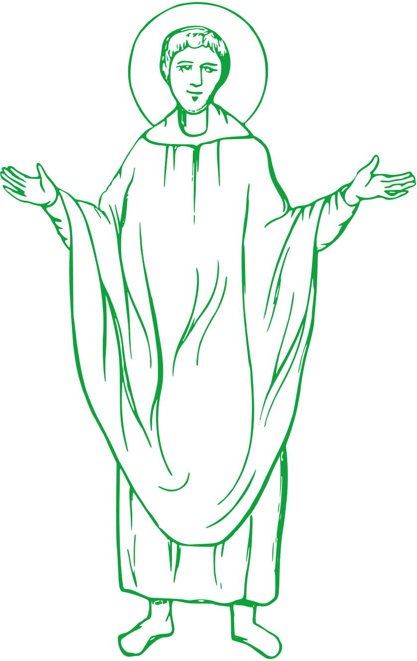
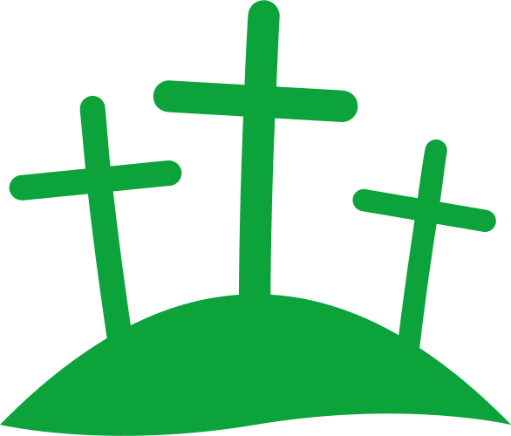
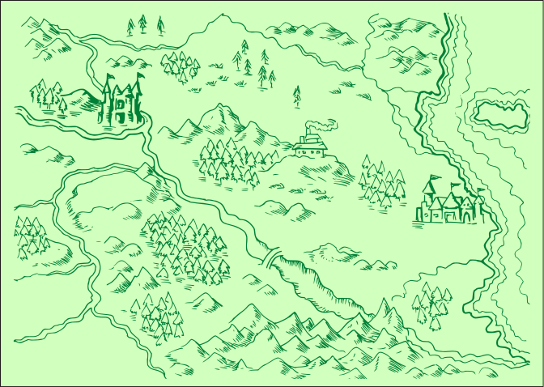
Chapter 5
EARLY CHRISTIAN IRELAND
2.6 CONSIDER the historical significance of Christianity on the island of Ireland, including its contribution to culture and society in the Early Christian period.
Estimated arrival of St. Patrick to Ireland as a bishop.
The Cathach of St Columba was created by Sitric of Kells, Co. Meath.
The Book of Kells originates from the Iona Abbey in Scotland.
Strand Two: The History of Ireland
Chapter Five: Early Christian Ireland
AD 431
AD 432
AD 462
AD 500
AD 600
AD 700
AD 795
Bishop Palladius arrives in Ireland to teach Christianity to the Irish pagans.
The Death of St. Patrick who is believed to be buried in Downpatrick.
The Book of Durrow was created on a site founded by Colum Cille in Co. Offaly.
The Arrival of the Vikings in Ireland marked the beginning of the raids..
@MsDoorley

Slide 3
Learning Outcomes
2.6 CONSIDER the historical significance of Christianity on the island of Ireland, including its contribution to culture and society in the Early Christian period.
1.3 APPRECIATE their cultural inheritance through recognising historically significant places and buildings and discussing why historical personalities, events and issues are commemorated
1.8 INVESTIGATE a repository of historical evidence such as a museum, library, heritage centre, digital or other archive or exhibition.
1.9 DEMONSTRATE awareness of the significance of history of Ireland and of Europe and the wider world across various dimensions including political, social, economic, religious, cultural and scientific dimensions.
Strand Two: The History of Ireland
Chapter Five: Early Christian Ireland
@MsDoorley

Slide 4
Introduction
In Ireland, the Iron Age - when iron was used to make tools and weapons - took place between 500 BC and AD 400. Towards the end of the Iron Age, by the early fifth century AD, Christianity had arrived in Ireland. This had an enormous impact on culture and society in Ireland. Many fascinating archaeological sites and a wealth of artefacts date from this time.
Strand Two: The History of Ireland
Chapter Five: Early Christian Ireland
@MsDoorley

Slide 5
AD 400 to AD 795
Chapter 5
5.1 THE ARRIVAL OF CHRISTIANITY IN IRELAND
5.1 The Arrival of Christianity in Ireland
Strand Two: The History of Ireland
@MsDoorley

Slide 6
Christianity Arrives in Ireland
Early Christian Ireland is the period when Christianity first came to Ireland. At that time, the people of Ireland were the Celts, farmers and warriors who had come from Central Europe and were pagans. A pagan is someone who worships various gods, often with a focus on nature or the earth. Druids were spiritual figures similar to priests in pre-Christian Celtic Ireland.
By the third century AD, the Roman Empire had spread as far as England and was mainly Christians. For historians, the first official source about Christianity in Ireland is dated AD 431, when a bishop named Palladius was sent to the ‘Irish who believe in Christ’.
The most famous bishop to travel to Ireland was St. Patrick. He was brought to Ireland from Wales as a slave when he was 16 years old. After six years, he escaped back to Britain but later returned as a bishop to spread Christianity. Between AD 432 and 461, St Patrick worked, mainly in the north, and founded many churches and missions. We know all of this from his book, ‘St. Patrick’s Confessio’. In it he says that he ‘baptised thousands’ and ‘ordained clerics everywhere’.St. Patrick began to convert the pagan Celts to Christianity.
Pagan festivals continued, but gradually became absorbed into Christianity: for example, Samhain became Hallowe’en. St. Patrick is said to be buried at Down Cathedral, Co. Down.
Strand Two: The History of Ireland
Chapter Five: Early Christian Ireland
@MsDoorley

Slide 7
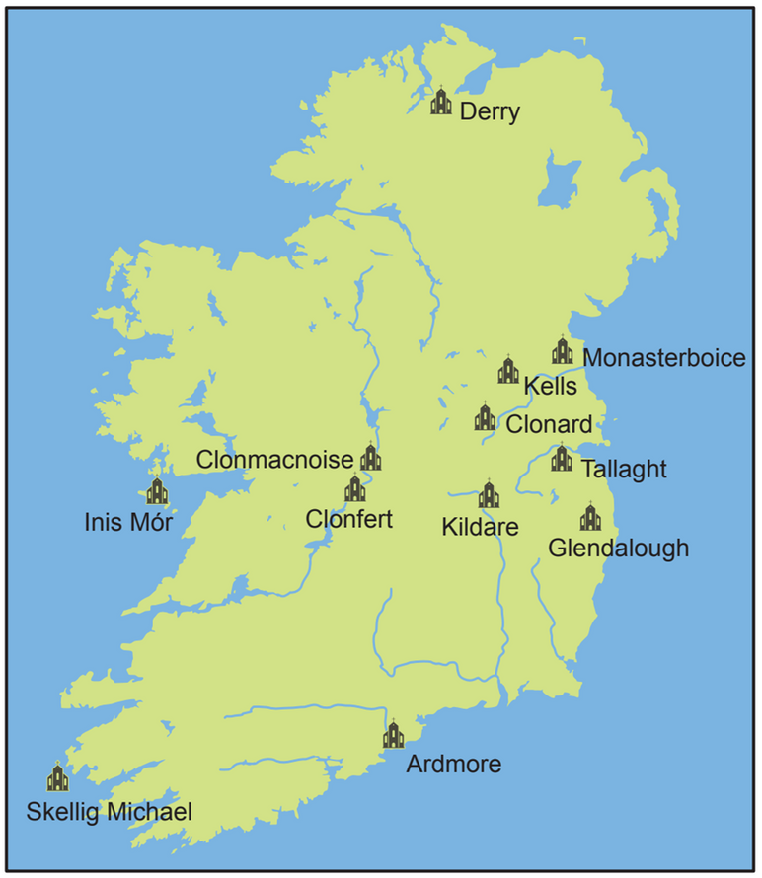
Early Irish Monasteries
Some Christians chose to live apart from the rest of society in a closed religious community (monastery) to devote their lives to God. The first Irish monastery called Inis Mór was founded by St Enda on the Aran Islands around AD 500. Many followed his example:
  St Ciarán in Clonmacnoise
  St Colmcille in Derry
  St Brendan in Clonfert
  St Kevin in Glendalough
Monks are men who dedicate themselves to a religious order and to life in a monastery. The monks lived very strict, simple lives and spent their days praying and working. They prayed six to eight times every day. Farm work included ploughing, milking, harvesting and grinding corn. The monks were often self-sufficient – they produced all the food they needed.
Strand Two: The History of Ireland
Chapter Five: Early Christian Ireland
Diagram taken from Artefact, 2nd Edition by Eimear Jenkinson and Gregg O'Neill (educate.ie)
@MsDoorley

Slide 8
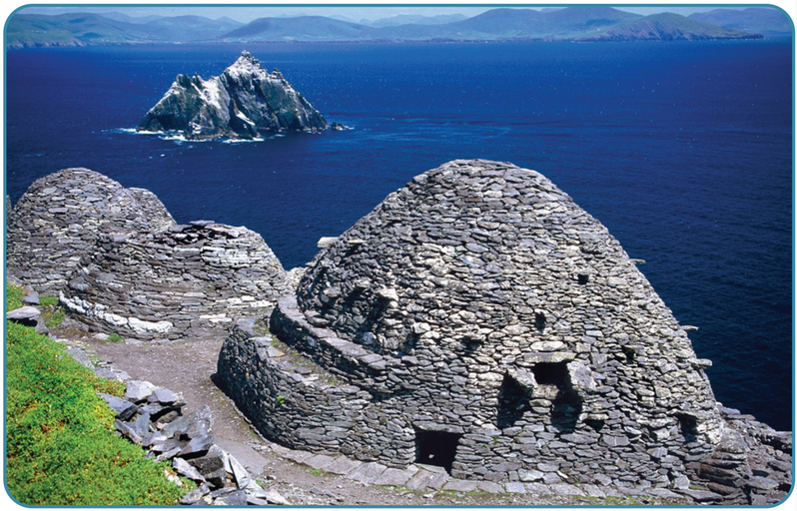
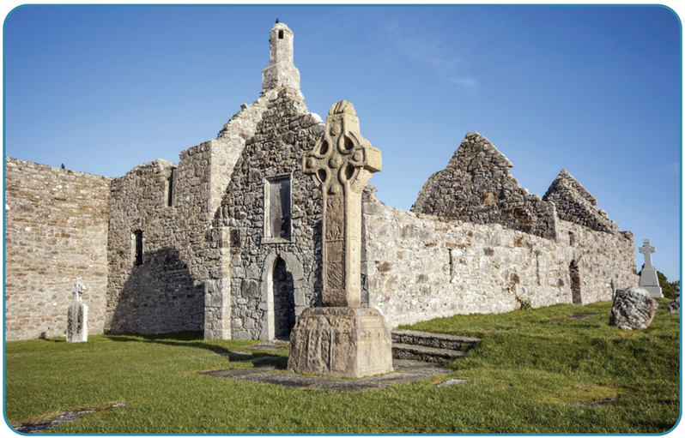
Early Irish Monasteries
Monasteries became centres of learning and were famous as the best in the world for the teaching of poetry, literature, arts and the Gospel. Ireland became known as ‘the Land of Saints and Scholars’, a saying that is still popular to this day. Large monasteries such as Clonard, Kells, Clonmacnoise, Glendalough and Clonfert were built along important routes and had regular contact with nearby towns. But small monasteries were also built in far more remote spots such as Sceilg Mhicíl in Co. Kerry.
On Sceilg Mhicíl, about a dozen monks lived on a steep rocky island with a small stone church. A beehive hut was a small stone hut, shaped like a beehive, where a monk slept. To plant and grow food, soil had to be brought from the mainland. The extreme isolation meant that monks could better focus on God and work.
Strand Two: The History of Ireland
Chapter Five: Early Christian Ireland
Diagram taken from Artefact, 2nd Edition by Eimear Jenkinson and Gregg O'Neill (educate.ie)
@MsDoorley

Slide 9
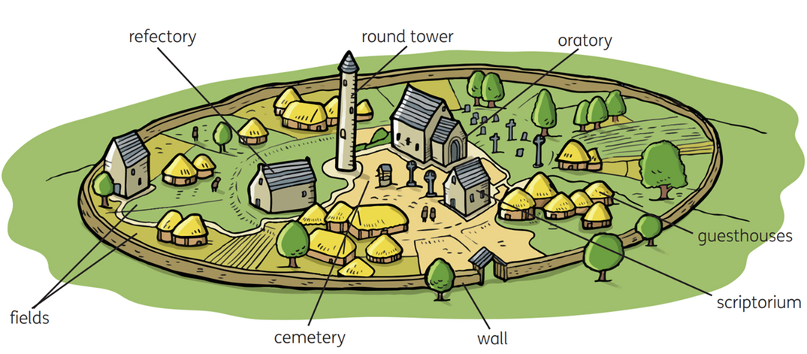
The layout of an early Irish monastery
The oratory (church) – made of wood or stone – was where monks attended Mass or prayed.
The scriptorium was where manuscripts were copied by hand and illustrated.
A manuscript is a book written by hand. The monks who did this work were called scribes.
The refectory was where the monks ate their meals.
The round tower was a bell tower and a safe place for people (and treasures) if the monastery came under attack. The door was many meters above ground and could not be reached without a ladder. Its few windows were very high up so that a lookout could spot attackers and access would be difficult. Many round towers are still visible in Ireland, including: Glendalough in Co. Wicklow, Kells in Co. Meath, Ardmore in Co. Waterford, Clonmacnoise in Co. Offaly.
Large monasteries had a guesthouse for travellers or visiting tradesmen.
All monasteries had fields to grow crops and graze animals.
There was a cemetery (graveyard) for the monks’ simple graves.
Large monasteries had a circular wall or bank for protection.
Strand Two: The History of Ireland
Chapter Five: Early Christian Ireland
Diagram taken from Artefact, 2nd Edition by Eimear Jenkinson and Gregg O'Neill (educate.ie)
@MsDoorley

Slide 10
Checkpoint (pg. 39, Artefact, 2nd Edition)
  When did Christianity arrive in Ireland?
  How did Christianity arrive in Ireland?
  Explain the terms monastery and beehive hut.
  Name three examples of Early Christian Ireland monasteries.
  Explain the terms scriptorium; refectory; oratory; round tower and manuscript.
Strand Two: The History of Ireland
Chapter Five: Early Christian Ireland

Slide 11
Checkpoint (pg. 39, Artefact, 2nd Edition)
  The first official source about Christianity in Ireland is dated AD 431.
  A bishop named Palladius was sent to the ‘Irish who believe in Christ’.
  Monastery: a closed religious community; Monks: men who dedicate themselves to a religious order and to life in a monastery.
  Any three of: Derry, Monasterboice, Kells, Clonard, Tallaght, Glendalough, Kildare, Clonfert, Clonmacnoise, Inis Mór, Ardmore, Skellig Michael.
  Scriptorium: a room where manuscripts were copied by hand and illustrated by scribes; Round tower: a bell tower and safe place for people and treasures if the monastery came under attack.
Strand Two: The History of Ireland
Chapter Five: Early Christian Ireland

Slide 12
AD 400 to AD 795
Chapter 5
5.3: THE ART OF EARLY CHRISTIAN IRELAND
5.3: the art of early christian ireland
Early Christian Ireland monasteries were famous for their great works of art, which were made to honour God and show the monastery’s importance. These works of art included manuscripts, metalwork and high crosses.
Early Christian monks continued to use the La Tene style art that had been brought to Ireland by the Celts.
Strand Two: The History of Ireland
@MsDoorley

Slide 13
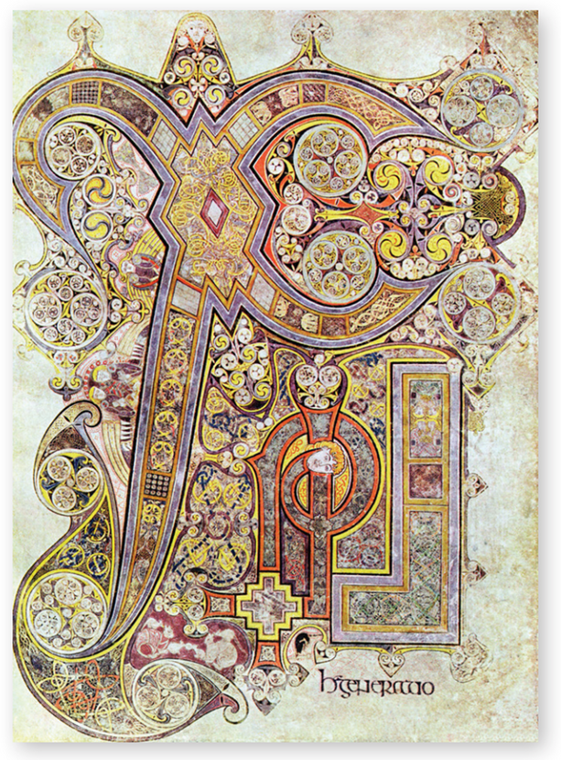
Manuscripts
Christianity helped to spread reading and writing in Ireland. Manuscripts contained the Gospels and the Psalms from the Bible, accounts of the lives of saints and also Celtic myths and sagas. They were written in Latin, on parchment made from sheepskin or vellum made from calfskin. They were decorated with Celtic patterns in vivid colours made from berries, crushed acorns, powdered rocks, metals and beetles. For pens, monks used quills – goose feathers sharpened and dipped in ink.
  The Cathach of St Columba is the oldest Irish manuscript. It dates from the late sixth century AD.
  The Book of Durrow was probably created between AD 600 and 700 and is kept in Trinity College Library.
  The most famous manuscript is the Book of Kells also kept at Trinity College Dublin. It dates from around AD 700-800 and is a beautifully decorated copy of the four Gospels. The Book of Kells attracts over 500,000 visitors to Trinity College each year! Every day a librarian very VERY carefully turns to a new page. It is, after all, over 1,200 years old.
Strand Two: The History of Ireland
Chapter Five: Early Christian Ireland
Diagram taken from Artefact, 2nd Edition by Eimear Jenkinson and Gregg O'Neill (educate.ie)
@MsDoorley

Slide 14
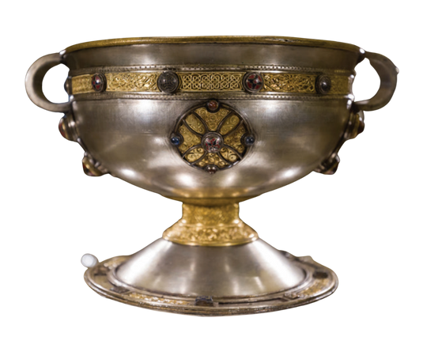
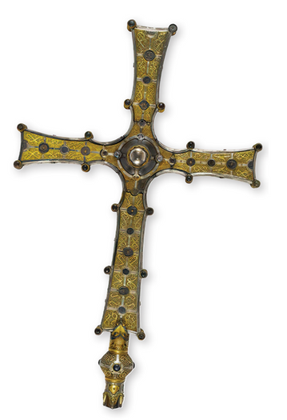
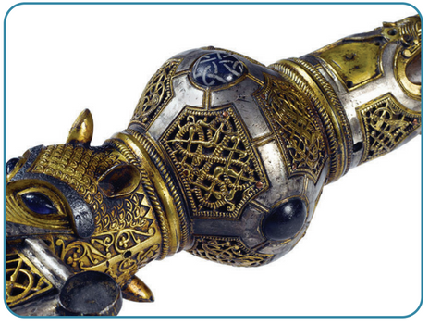
Metalwork
Irish monks were very skilled craftsmen and created beautiful metalwork pieces. These included: chalices, brooches, bells, cups and belts.
The monks decorated silver with gold, amber, enamel and coloured glass. They also made intricate gold writing, called filigree.
Celtic designs can be seen in their work, which shows overlap between Christian beliefs and pagan traditions.
  The Ardagh Chalice (eighth century) and the Derrynaflan Chalice (early ninth century) are examples of chalices made using these skills.
  The Bell of St Patrick and its Shrine (cover) is another example.
  The bell dates from the eighth to the ninth century, while the shrine is from a later date.
  The Cross of Cong is a later example of detailed metalwork (early twelfth century).
  All of these are on display in the National Museum in Dublin.
Strand Two: The History of Ireland
Chapter Five: Early Christian Ireland
Diagram taken from Artefact, 2nd Edition by Eimear Jenkinson and Gregg O'Neill (educate.ie)
@MsDoorley

Slide 15
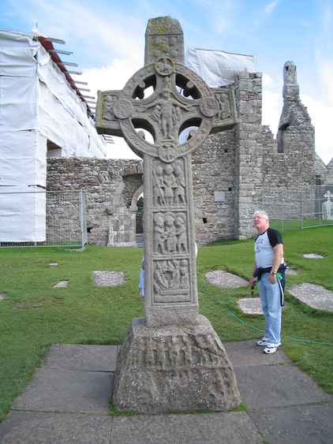
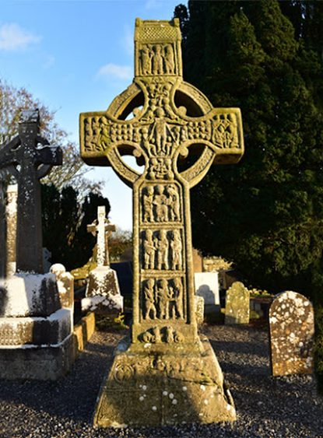
Stonemasonry - Stone Crosses
Stonemasonry was very important in Early Christian Ireland. Gifted stonemason monks carved what we call high crosses. A high cross is a free-standing stone cross, usually with elaborate carvings showing biblical scenes.
For example; the story of Adam and Eve or the Crucifixion of Christ. Most people at that time could not read or write so these scenes helped teach Bible stories. Complex Celtic patterns surrounded these scenes – like a page border. Two of the most beautiful high crosses in Ireland are:
  The Cross of the Scriptures in Clonmacnoise, Co. Offaly (late tenth century)
  Muiredach’s Cross in Monasterboice, Co. Louth (mid-ninth to early tenth century).
Strand Two: The History of Ireland
Chapter Five: Early Christian Ireland
Diagram taken from Artefact, 2nd Edition by Eimear Jenkinson and Gregg O'Neill (educate.ie)
@MsDoorley

Slide 16
Checkpoint (pg. 41, Artefact, 2nd Edition)
  Name three types of art produced by Irish monks.
  What was the La Tene style?
  What materials were used in the scriptorium?
  Name two examples of metalwork from Early Christian Ireland.
  Describe the kinds of decorations on metal work pieces/
  Explain the terms: manuscript and high cross.
  Why did monks carve scenes from the Bible on high crosses?
Strand Two: The History of Ireland
Chapter Five: Early Christian Ireland

Slide 17
AD 400 to AD 795
Chapter 5
5.3: THE IMPACT OF IRISH MONKS ABROAD
5.3: the impact of irish monks abroad
Strand Two: The History of Ireland
@MsDoorley

Slide 18
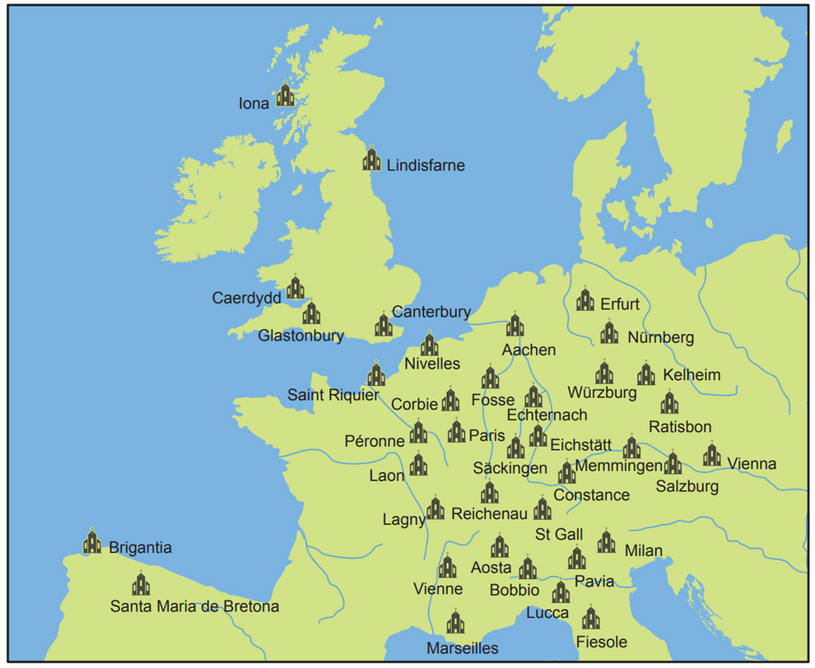
The Golden Age of Irish Monasteries
After the fall of the Western Roman Empire, much of Europe went through a period of unrest known as the Dark Ages (AD 500 to 1000). These hard and savage times – and later, the new threat of Viking attacks at home – led to many monks travelling abroad to found monasteries throughout Europe. These Irish monks produced manuscripts in the Irish style and worked to convert Europe to Christianity. This period of time was known as the ‘Golden Age’ of Irish monasteries.
St Columbanus left a monastery in Bangor, Co. Down to found several monasteries including Luxeuil in France and Bobbio in Italy.
St Colmcill left Ireland at the age of 44 to found the monastery on the island of Iona (off the coast of Scotland). Iona is actually where the Book of Kells was made – it was simply found in Kells much later.
Strand Two: The History of Ireland
Chapter Five: Early Christian Ireland
Diagram taken from Artefact, 2nd Edition by Eimear Jenkinson and Gregg O'Neill (educate.ie)
@MsDoorley

Slide 19
Checkpoint (pg. 42, Artefact, 2nd Edition)
  Why do you think war followed the fall of the Roman Empire?
  Explain what is meant by the Dark Ages.
  What work did Irish monks do when they went abroad?
  Name three modern European countries where Irish monks founded monasteries.
Strand Two: The History of Ireland
Chapter Five: Early Christian Ireland

Slide 20
Checkpoint (pg. 42, Artefact, 2nd Edition)
  Why do you think war followed the fall of the Roman Empire?
    Because each of the territories from the Roman Empire wanted to establish themselves as independent countries.
  Explain what is meant by the Dark Ages.
    The period 500-1000 AD that saw war throughout Europe. It is also a period of time for which we have limited written sources from.
  What work did Irish monks do when they went abroad?
    They founded monasteries.
    They created manuscripts.
    They converted pagans to Christianity.
  Name three modern European countries where Irish monks founded abroad.
Strand Two: The History of Ireland
Chapter Five: Early Christian Ireland
  Portugal
  Scotland
  England
  Wales
  Belgium
  France
  Italy
  Spain
  Netherlands
  Luxembourg
  Austria
  Switzerland
  Denmark

Slide 21
AD 400 to AD 795
Chapter 5
5.4: THE ARRIVAL OF THE VIKINGS
5.4: the arrival of the vikings
Strand Two: The History of Ireland
@MsDoorley

Slide 22
The Vikings
In eight-century Scandinavia (modern-day Denmark, Sweden and Norway), the people we know as Vikings were farmers and fishermen.
Their superb shipbuilding and navigational skills allowed them to voyage to many countries, including Ireland.
The Vikings’ boats were called longships, capable of crossing stormy seas but still shallow enough to sail up rivers.
Strand Two: The History of Ireland
Chapter Five: Early Christian Ireland
Diagram taken from Artefact, 2nd Edition by Eimear Jenkinson and Gregg O'Neill (educate.ie)
@MsDoorley

Slide 23
Viking raids on Ireland
The first record Viking attacks on Ireland took place in AD 795, focusing on rich monasteries. Those on Lambay Island, Co. Dublin and Rathlin Island, Co. Antrim were both pillaged and burned that year. By the mid-ninth century, the Vikings were establishing longphorts, camps by the water used as a base for raids. Many longphorts were temporary while others grew into important trade points and eventually large towns. Wexford, Waterford, Limerick and Dublin were all once longphorts.
Early Christian monasteries were easy targets for raiders. To the pagan Vikings, Christian monasteries were not sacred in any way – they were isolated places, full of treasure and with no warriors to defend them.
The Vikings also took captives to sell as slaves along with cattle and food stores. Round towers were very useful in Irish monasteries for warning and protection in times of attacks – but not just by Vikings as the native Irish also attacked (also pagans).
Strand Two: The History of Ireland
Chapter Five: Early Christian Ireland
Diagram taken from Artefact, 2nd Edition by Eimear Jenkinson and Gregg O'Neill (educate.ie)
@MsDoorley

Slide 24
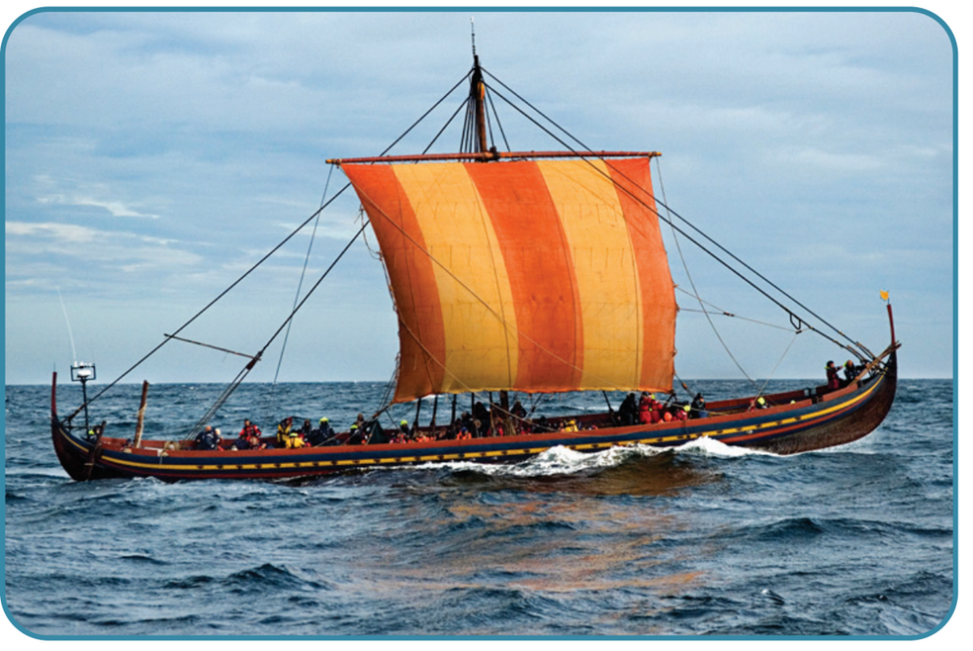
Viking settlements in Ireland
Over time, the Vikings who settled in Ireland intermarried with Gaelic people and adopted Gaelic culture and customs (became Gaelicised). Eventually, the Vikings disappeared as a distinct group in Ireland but they had deeply influenced Irish culture and society.
  They introduced currency (coins) to Ireland and opened more trade liks with Europe.
  They introduced new words to the Irish language such as long (ship), bróg (shoe), margadh (market), pingin (penny) and breá (good, fine).
  Many Irish surnames are Viking in origin, for instance McLoughlin, Doyle, Higgins, O'Rourke, Reynolds and McAuliffe.
Strand Two: The History of Ireland
Chapter Five: Early Christian Ireland
Diagram taken from Artefact, 2nd Edition by Eimear Jenkinson and Gregg O'Neill (educate.ie)
@MsDoorley

Slide 25
A Viking Settlement: Dublin
  The most prominent archaeological find of Viking remains and examples of beautiful craftsmanship were found in Dublin at Wood Quay, Christ Church and the Temple Bar area.
  At Wood Quay, remains of about 200 houses from the tenth and eleventh centuries were uncovered, giving us a wealth of information about Viking life in Ireland.
  The houses were rectangular and their thatched roofs (of barley straw) were supported by posts inside the house.
  The walls were wattle and daub, a woven mesh plaster with a mixture of mud, dung, sand and straw. Once dry, it was quite strong and helped insulate the house against Irish weather. Inside, hearths (for a fire) and benches were found, along with evidence of workshops.
  Streets and pathways were surfaced with gravel, stones, wattle mats or split logs. Back yards were divided by posts and wattle fences.
  Even toilet areas and rubbish pits were identified (the Vikings were very clean when not at war).
  Other amazing artefacts such as glass beads, necklaces and brooches were found there.
  Underneath Dublin’s streets lay the archaeological footprint of many generations who lived in the bustling international port known to the Vikings as Dyfflin.
Strand Two: The History of Ireland
Chapter Five: Early Christian Ireland
@MsDoorley

Slide 26
Checkpoint (pg. 43, Artefact, 2nd Edition)
  Explain the terms longphorts and longship.
  When did the Vikings arrive in Ireland?
  List two examples of Viking sites in Dublin.
  Name three things found in Wood Quay by archaeologists.
Strand Two: The History of Ireland
Chapter Five: Early Christian Ireland

Slide 27
Checkpoint (pg. 43, Artefact, 2nd Edition)
  Explain the terms longphorts and longships.
    Longphorts - raiding bases for the Vikings to attack the native Irish and monasteries from.
    Longships - the boats built by the Vikings that could brace the sea and rivers.
  When did the Vikings arrive in Ireland?
    795 AD
  List two examples of Viking sites in Dublin.
    Wood Quay
    Christ Church
    Temple Bar
  Name three things found in Wood Quay by archaeologists.
    Brooches
    Glass beads
    Houses
    Tools used
Strand Two: The History of Ireland
Chapter Five: Early Christian Ireland

Slide 28
AD 400 to AD 795
Chapter 5
5.5: THE HISTORICAL SIGNIFICANCE OF EARLY CHRISTIAN IRELAND
5.5: the historical significance of early christian ireland
Strand Two: The History of Ireland
@MsDoorley

Slide 29
Historical Significance
Since its arrival on the island of Ireland, Christianity has shaped Irish identity, beliefs, practices and customs. Early Christian monasteries can be found all around Ireland and metalwork, stonework and manuscripts created there are conserved in our museums.
Early Christian Ireland influenced the Irish landscape, as many place names reveal a religious origin, for example Kilkenny, Monasterevin and Downpatrick. The Early Christian Irish Church cleverly absorbed some pagan rituals and beliefs, such as holy wells, into their practices, which ensured that Christianity quickly became the dominant religious tradition in Ireland. According to the 2016 Census figures, 84.6% of the population of the Republic of Ireland identifies as Christian.
Since the Plantations, divisions within Christianity on the island - between Catholics and Protestants - have made religion a key factor in Irish history (we will learn more about them next year).
Many of the symbols that represent Ireland to this day can be linked to the history of Christianity on the island. One such symbol is Brigid's cross, a cross of woven rushes which is traditionally linked to St Brigid of Kildare. Another symbol that represents Ireland is the shamrock which is associated with St Patrick who used it to explain the Holy Trinity. The Shamrock is used as the symbol for the Irish national rugby and soccer teams.
The Republic of Ireland's national holiday is on 17th March and is dedicated to St Patrick, the patron saint of Ireland. In countries such as the USA and Australia, people who are part of the Irish diaspora come together to mark St Patrick's Day with many wearing the shamrock to celebrate their Irish heritage.
Strand Two: The History of Ireland
Chapter Five: Early Christian Ireland
Diagram taken from Artefact, 2nd Edition by Eimear Jenkinson and Gregg O'Neill (educate.ie)
@MsDoorley

Slide 30
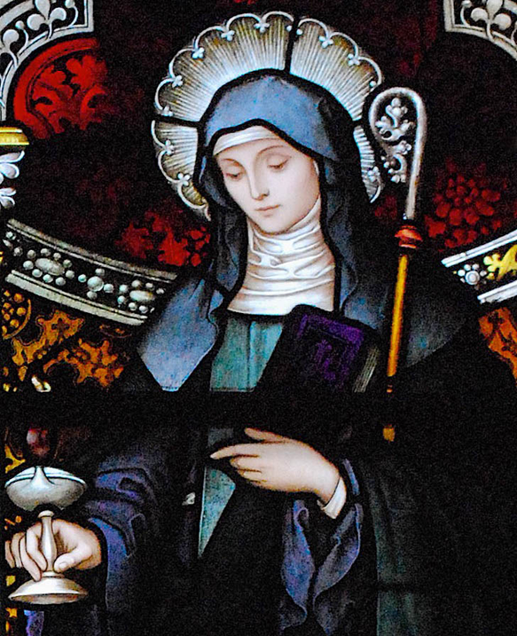
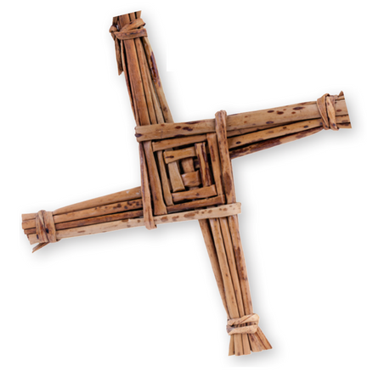
St Brigid of Kildare, c. AD 451-525
St Brigid of Kildare is one of Ireland's three patron saints. She was an Early Christian Irish nun, abbess and foundress of several convents. St Brigid's Convent in Co. Kildare was founded in AD 470 - even earlier than Inis Mór. Her feast is 1st February. This was originally a pagan festival called Imbolc, which marked the beginning of spring and was associated with a popular Celtic goddess of the same name. The few historical details on St Brigid are all from Christian sources dated centuries after her death, while the stories about her contain elements of folklore and strong similarties to the goddess. Some have suggested that St Brigid was not a real figure, but an invention of the Church.
Strand Two: The History of Ireland
Chapter Five: Early Christian Ireland
St Brigid's Cross taken from Artefact, 2nd Edition by Eimear Jenkinson and Gregg O'Neill (educate.ie); St Brigid taken from Wikipedia.
@MsDoorley

Slide 31
Checkpoint (pg. 42, Artefact, 2nd Edition)
  Give two examples of place names in Ireland that reveal a religious origin.
  What percentage of the Irish population identifies as Christian, according to the 2016 census?
  Name two Irish symbols.
  When is the Republic of Ireland's national holiday?
  Name a patron saint of Ireland.
Strand Two: The History of Ireland
Chapter Five: Early Christian Ireland

Slide 32
Checkpoint (pg. 42, Artefact, 2nd Edition)
  Give two examples of place names in Ireland that reveal a religious origin.
    Kilcormac
    Monasterevin
    Downpatrick
    Kilkenny
  What percentage of the Irish population identifies as Christian, according to the 2016 census?
    84.6%
  Name two Irish symbols.
    Shamrock
    Brigid’s Cross
    The Harp
  When is the Republic of Ireland's national holiday?
    17th March - St Patrick‘s Day
  Name a patron saint of Ireland.
    St Patrick
    St Brigid
    St Columba
Strand Two: The History of Ireland
Chapter Five: Early Christian Ireland

Slide 33
AD 400 to AD 795
Chapter 5
5.6: SUMMARY
5.6: summary
Strand Two: The History of Ireland
@MsDoorley

Slide 34
In this chapter, we learned that...
  Early Christian Ireland is the period when Christianity first came to Ireland.
  A bishop called Palladius was sent to Ireland in AD 431 to spread Christianity.
  The most famous bishop to travel to Ireland was St. Patrick between 432 and 461.
  From the sixth century on, many monasteries were build on island. The first monastery, named Inis Mór, was founded by St. Enda. The first convent was founded by St. Brigid at Kildare.
  Other examples of monasteries include Clonard, Kells, Clonmacnoise, Glendalough, Clonfert and Sceilg Mhicíl.
  Some monastery buildings were: beehive huts, an oratory, a refectory, a scriptorium and a round tower.
  Art created by the monks included manuscripts, metalwork and stone high crosses.
  The Vikings began to raid and settle in Ireland in the eighth century.
  Amazing evidence giving insight into their lives in Dublin was found at Wood Quay.
  Many Irish monks went abroad to save or spread Christianity.
  This period is historically significant for the island of Ireland and has impacted Irish identity.
Strand Two: The History of Ireland
Chapter Five: Early Christian Ireland
Diagram taken from Artefact, 2nd Edition by Eimear Jenkinson and Gregg O'Neill (educate.ie)
@MsDoorley

Slide 35
Reflecting on... Early Christian Ireland
The arrival of Christianity to the island of Ireland is historically significant. Christianity helped to spread reading and writing in Ireland. Irish monasteries became centres of learning. Great works of art were also created by Irish monks. Christainity therefore contributed to the culture and society of Early Christian Ireland.
Strand Two: The History of Ireland
Chapter Five: Early Christian Ireland

Slide 36
SEC Examination Questions
2022 SEC Q1g
Strand Two: The History of Ireland
Chapter Five: Early Christian Ireland
@MsDoorley

Slide 37
Project
Guidelines:
  Length: The depth of your project should reflect about 2-3 weeks of work.
  Sources: Use at least three different sources for your research. These can be books, scholarly articles, or reputable online resources.
  Citations: All information and images that are not your own should be properly cited.
  Mediums: You may choose to present your project in one of the following ways:
    Poster: Your poster should be informative and visually engaging.
    Minecraft or Lego Model: If choosing this option, please also include a brief report explaining your model.
    Painting/Drawing: Your artwork should be accompanied by a description.
    Recycled Materials: Create your model using recycled materials and provide an explanation of your creative process.
Assessment:
Your projects will be assessed based on:
  Research and Content
  Creativity and Presentation
  Understanding of Context
  Adherence to Guidelines
Strand Two: The History of Ireland
Chapter Five: Early Christian Ireland
@MsDoorley

Slide 38
Project
Historical Sites
Historical Figures
Skellig Michael, County Kerry
Clonmacnoise, County Offaly
Glendalough, County Wicklow
Monasterboice, County Louth
Rock of Cashel, County Tipperary
St Patrick
St Brigid
St Colmcille
St Columbanus
St Ciarán
St Íte
Brendan the Navigator
Strand Two: The History of Ireland
Chapter Five: Early Christian Ireland
@MsDoorley

